Slide 1
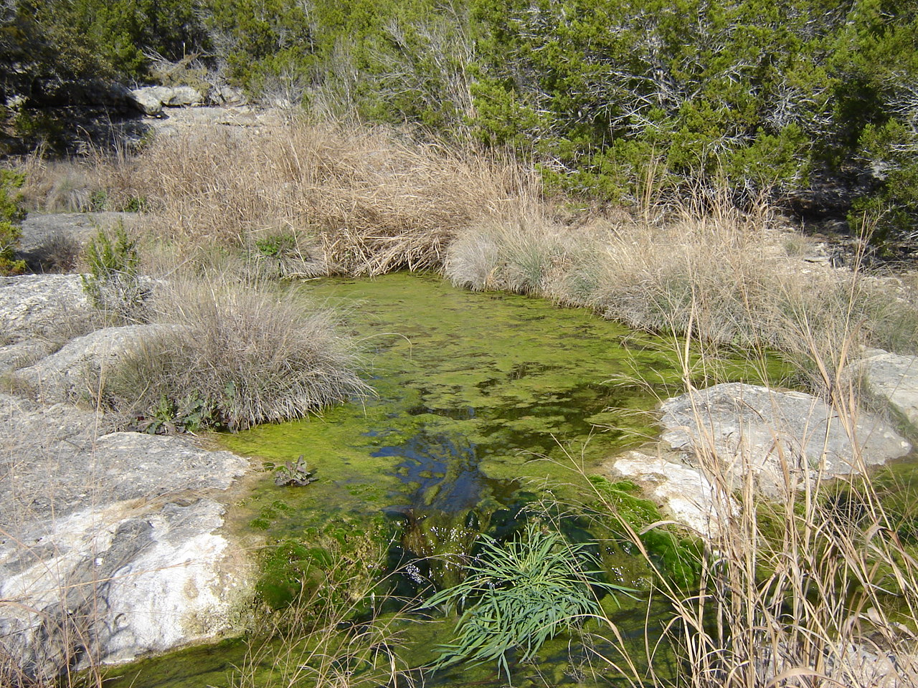

Land-Applied Wastewater Effluent Impacts on the Edwards Aquifer
by:
D. Lauren Ross, Ph. D., P. E.
Glenrose Engineering, Inc.
512.326.8880
glenrose.com

Slide 2


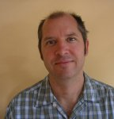
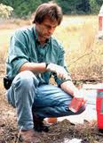

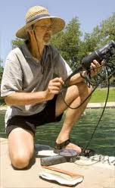

Acknowledgements:
City of Austin
U.S. Geological Survey
BS/EACD
LCRA

Slide 4
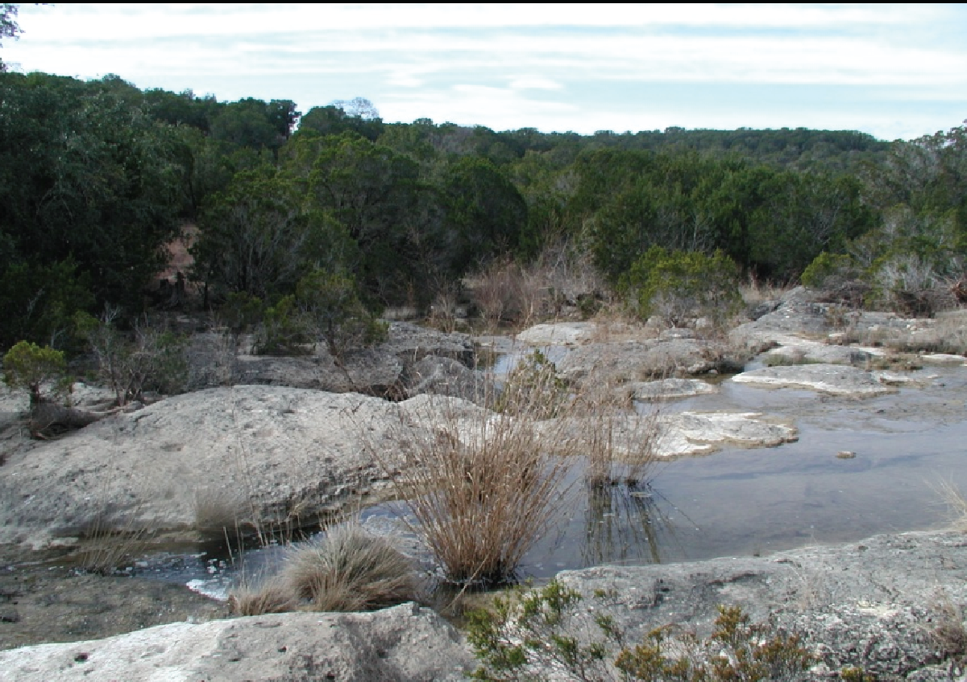
Fragile Streams
Naturally low flow
Naturally low nutrients

Slide 5
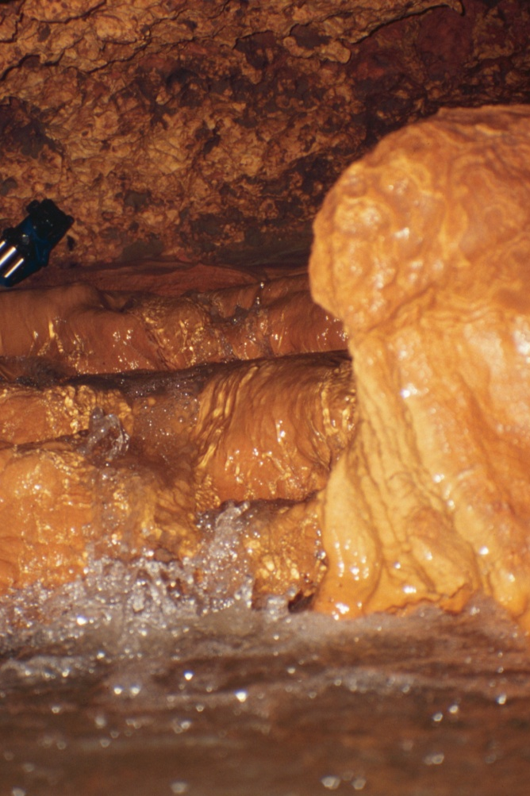
Fragile Aquifer
Rapid Flow
No Filtration
Recharged through both Upland and Stream Features

Slide 6
Texas Land Application Permits in the San Antonio and Barton Springs Edwards Aquifer Recharge Zones
NONE

Slide 7
Texas Land Application Permits in the San Antonio and Barton Springs Edwards Aquifer Contributing Zones
67

Slide 8
Texas Land Application Permits
San Antonio and Barton Springs Edwards Aquifer Contributing Zones
Barton Springs Edwards Aquifer Contributing Zone: 26
San Antonio Edwards Aquifer Contributing Zone: 41

Slide 9
24 Times the TLAPed Effluent in the Barton Springs Compared to the
San Antonio Edwards Aquifer Contributing Zones on an Area Basis

Slide 10
What Determines A Protective TLAP?
Effluent Treatment Technology
Effluent Treatment Standards
Effluent Storage Requirements
Irrigation Area Requirements

Slide 11
Different Effluent Treatment Technologies
Activated Sludge: 44 (70%)
Membrane Bioreactor: 2 (3%)
Others:
  Facultative Lagoon
  Septic Tank
  Not Specified (2)

Slide 12
Widely Different Effluent Standards
Daily Average BOD and TSS Range from 5 to 30 mg/l
16 have no effluent limits
Only 10 with nutrient limits
Only 2 with total nitrogen limits

Slide 13
Widely Different Effluent Storage Requirements
21 Systems with no storage requirement
Required Days Storage Ranges from 0.08 to 308 Days
Average for Subsurface Irrigation: 5.8 Days
Average for Surface Irrigation: 70 Days

Slide 14
Widely Different Effluent Irrigation Area Requirements
Application Rates Range from 0.08 to 12.20 acre-feet per acre per year
The most common rate is 4.88 acre-feet per acre per year (0.1 gal/day/sf)

Slide 15
Evidence of Stream Degradation
No Monitoring Requirements
Nutrients are Most Mobile
Compounding and Confusing Nutrient Sources
Nutrients can “disappear” out of the water column into algae growth

Slide 16
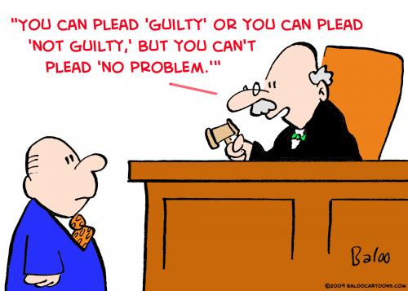

Slide 17
Nitrate Concentration in Barton Creek Canyons Baseflow (COA, 1997)

Slide 18
Degradation Evidence: Belterra Subdivision

Slide 19
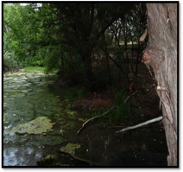
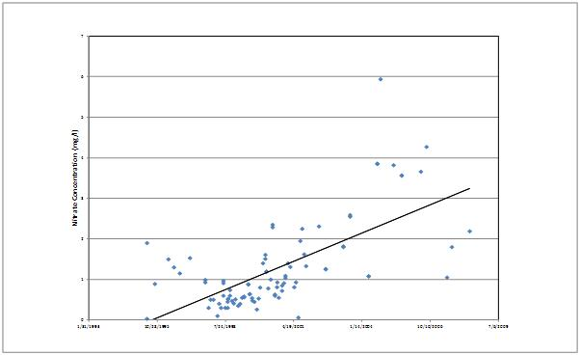
Degradation Evidence: Barton Creek West
Increasing Nitrate Concentrations in Scenic Bluff Springs Over Time

Slide 20
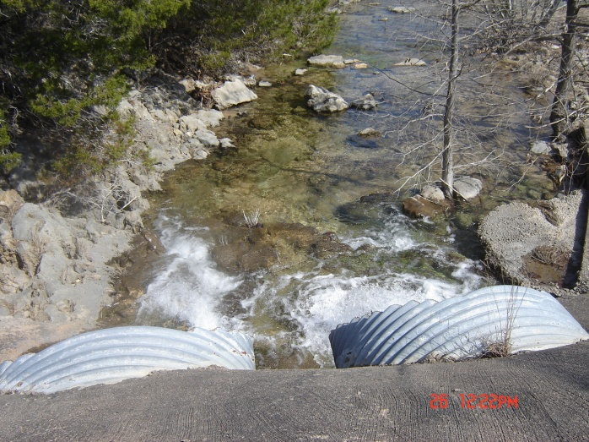
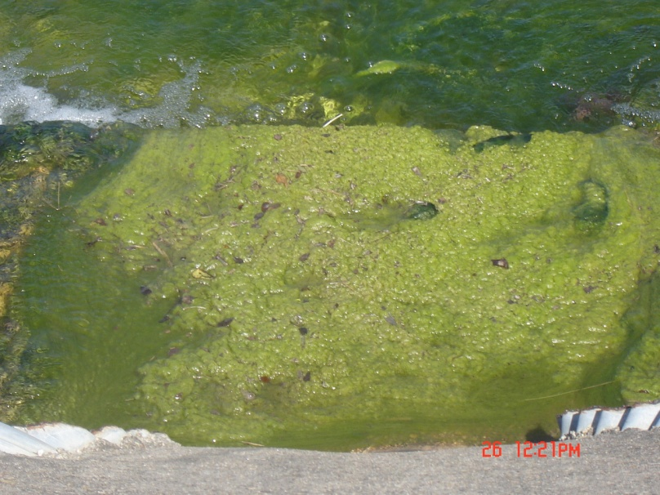
Degradation Evidence: West Cypress Hills
Algae in East Lick Creek Downstream from Pedernales Canyon Trail
West Lick Creek Downstream from Pedernales Canyon Trail

Slide 21
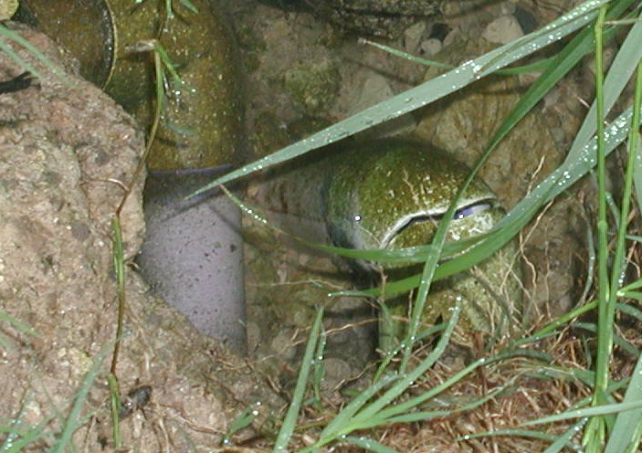
Degradation Evidence: West Cypress Hills
Broken Effluent Irrigation Pipe

Slide 22
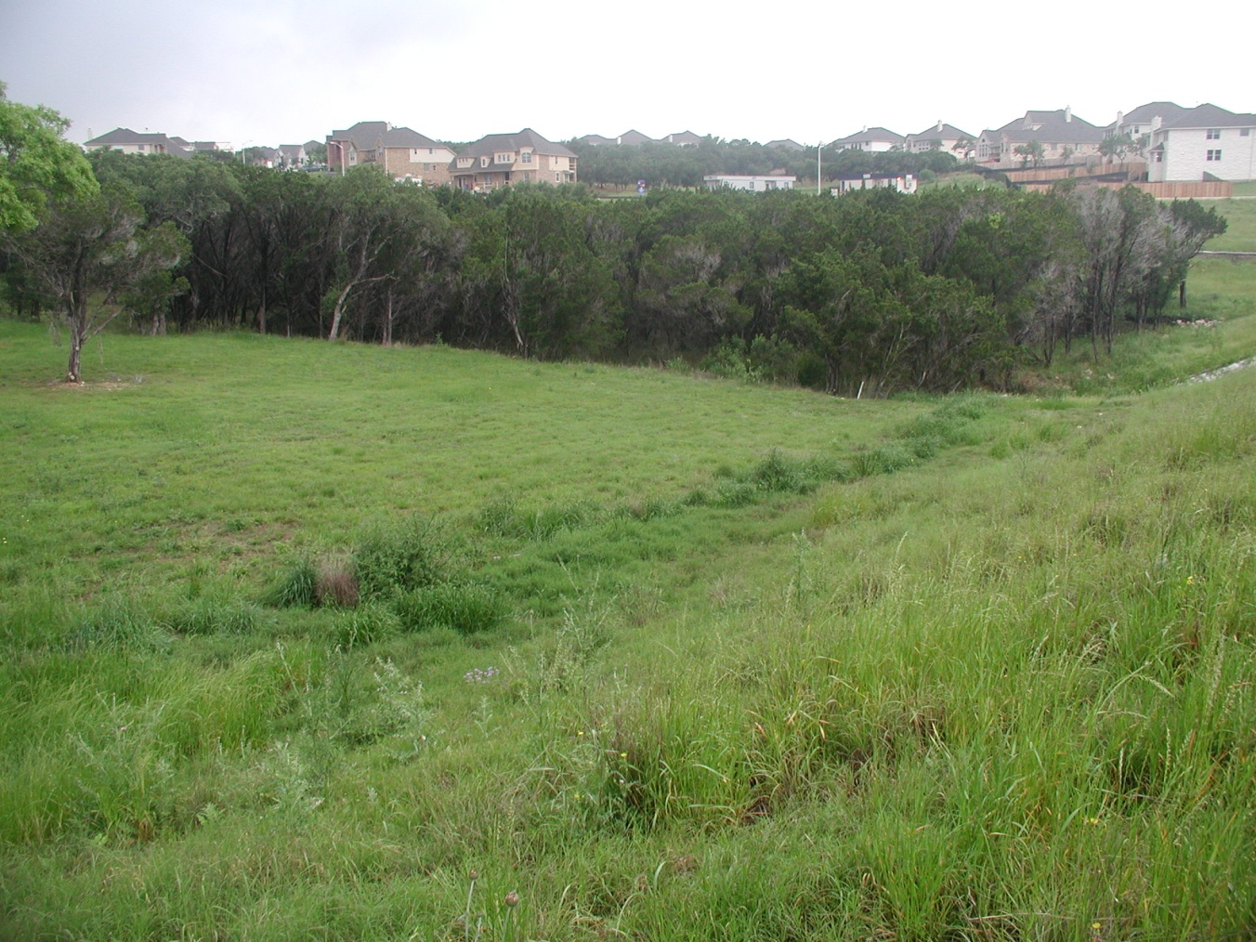
Degradation Evidence: West Cypress Hills
Broken Effluent Irrigation Pipe

Slide 23
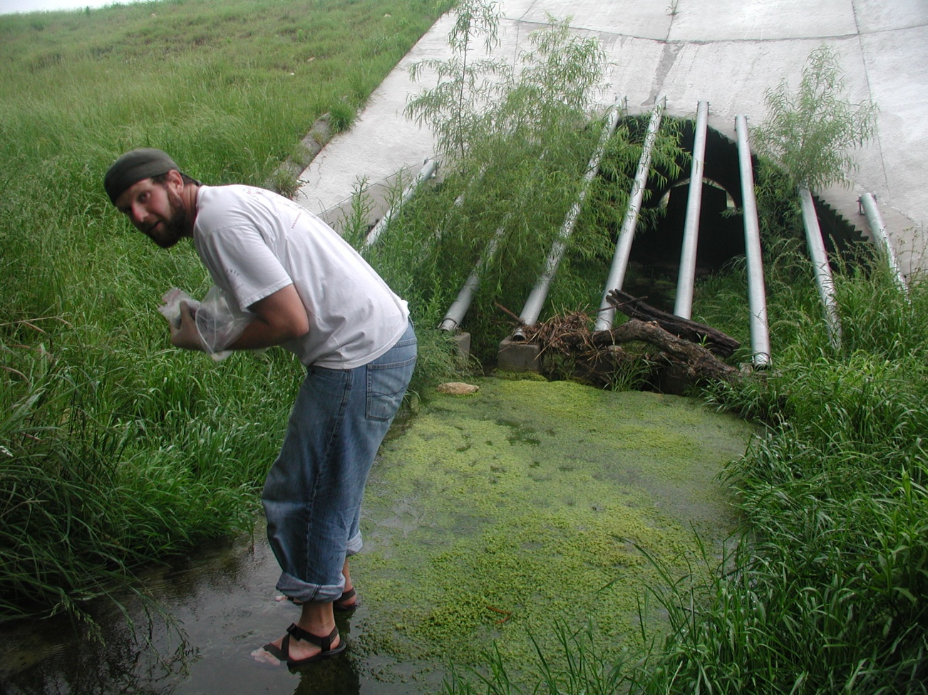
Degradation Evidence: West Cypress Hills
Lick Creek Below Broken Effluent Irrigation Pipe

Slide 24
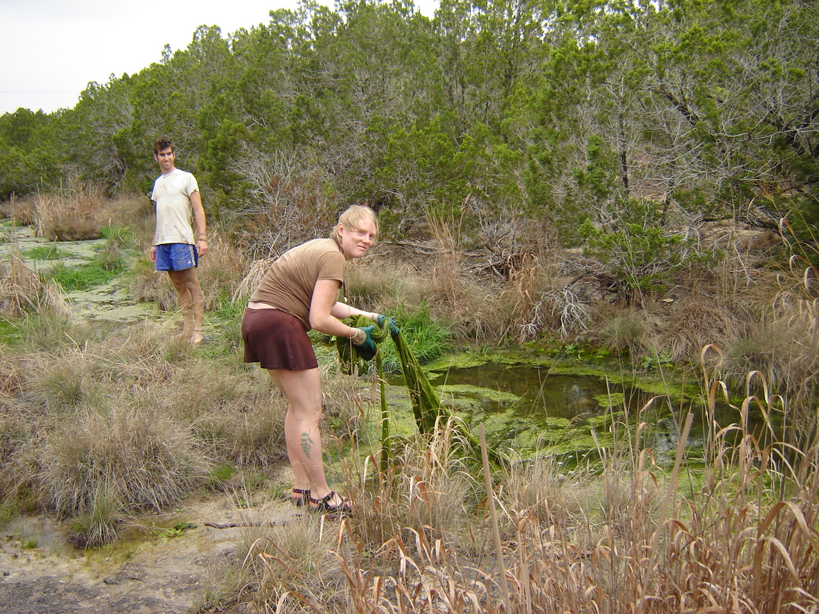
Degradation Evidence: West Cypress Hills
Algae Down Stream from Effluent Irrigation

Slide 25
Degradation Evidence: West Cypress Hills

Slide 26
TLAP Noncompliance
Failure to Monitor Soil: Only 2 of 64 TLAPs with reported data
Application Misinformation (Jeremiah Venture):
  Effluent Irrigation Proposed for Rocky Soils
  Failure to Identify Karst Features
  Water Balance Based on Western Evapotranspiration Values

Slide 27
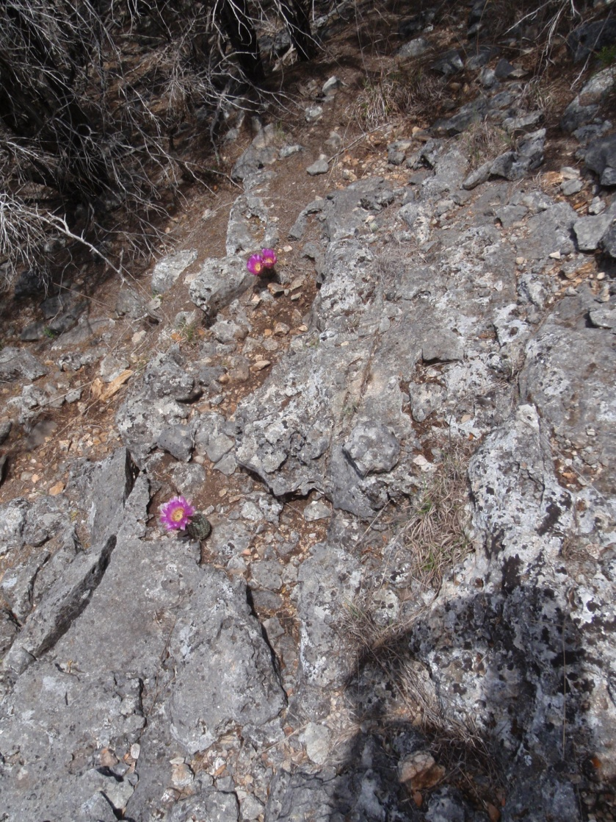
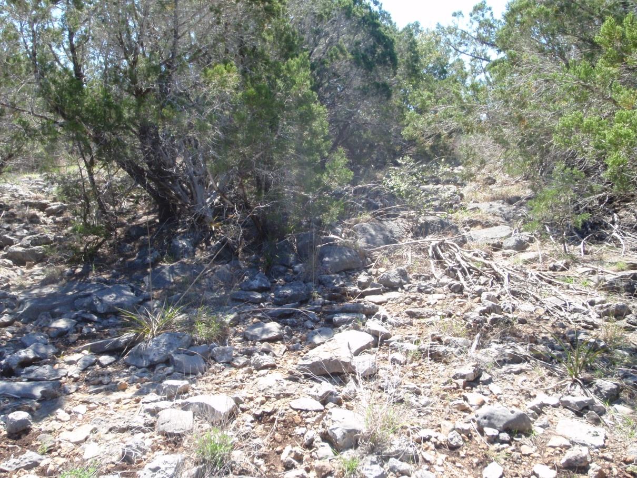
Effluent Irrigation Proposed for Rocky Soils

Slide 28
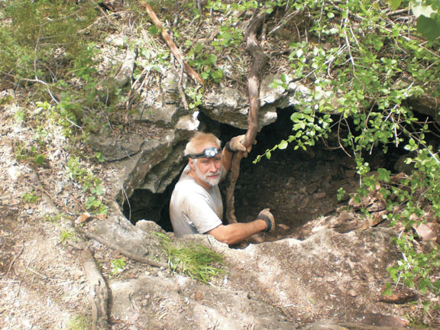
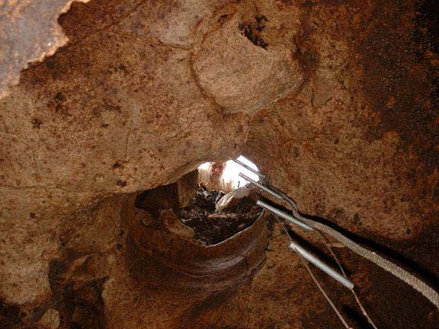
Failure to Identify Recharge Features
Images from Hauwert, Preliminary Phase I Assessment of the Jeremiah Ventures Site, September 25, 2009.

Slide 29
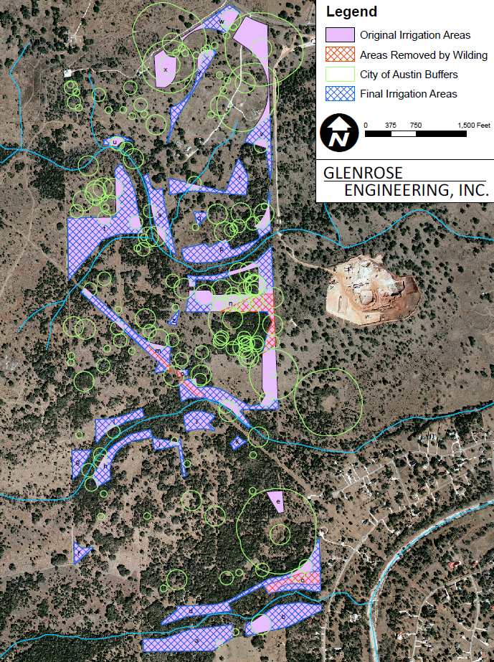
Failure to Identify Recharge Features

Slide 30
Misuse of Water Balance Method

Slide 31
TLAP Recommendations
Eliminate TLAPs on the Edwards Aquifer Recharge Zone

Slide 32
TLAP Recommendations
Eliminate TLAPs on the Edwards Aquifer Recharge Zone
Establish Consistent Effluent Limits
  Total Nitrogen: 3 milligrams per liter
  Total Phosphorous: 0.1 milligram per liter

Slide 33
TLAP Recommendations
Standardize Effluent Irrigation Requirements

Slide 34
TLAP Recommendations
Standardize Effluent Irrigation Requirements
Standardize Effluent Storage Requirements

Slide 35
TLAP Recommendations
Standardize Effluent Irrigation Requirements
Standardize Effluent Storage Requirements
Eliminate Leaching Allowance

Slide 36
TLAP Recommendations
Standardize Effluent Irrigation Requirements
Standardize Effluent Storage Requirements
Eliminate Leaching Allowance
Require Soil, Spring, Stream, and Well Monitoring with Re-permitting Triggers

Slide 37
TLAP Recommendations
Standardize Effluent Irrigation Requirements
Standardize Effluent Storage Requirements
Eliminate Leaching Allowance
Require Soil, Spring, Stream, and Well Monitoring with Re-permitting Triggers
Require Soil Monitoring and Automatic Response to Saturated or Frozen Soil Conditions

Slide 38
